Slide 2
Osteopathic - Section 7

Slide 3
Objectives
Understanding section Osteopathic
Clinical examples for better understanding
Knowledge Check
Exercises

Slide 4
Osteopathic
Section 7, Osteopathic, is one of the smallest sections in ICD-10-PCS. There is a single body system, Anatomical Regions, and a single root operation, Treatment.
The sixth-character methods such as Lymphatic Pump and Fascial Release are not explicitly defined in ICD-10-PCS, and rely on the standard definitions as used in this specialty.

Slide 5
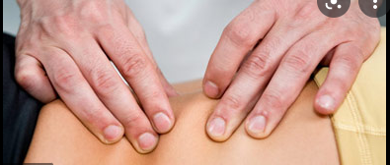
Osteopathic-Treatment
Treatment is defined as Manual treatment to eliminate or alleviate somatic dysfunction and related disorders.
Somatic dysfunction is a functional impairment and is defined as impaired or altered functions of related components of the somatic (body framework) system. It can include the musculoskeletal, nervous, or lymphatic systems. Somatic dysfunction occurs from a mechanical restriction first followed by an increase in muscle tone or spasm.
Examples of osteopathic treatment are:
Fascial release
Osteopathic treatment
General osteopathic mobilization of Extremities
Lymphatic pump osteopathic treatment
Myofascial release

Slide 6
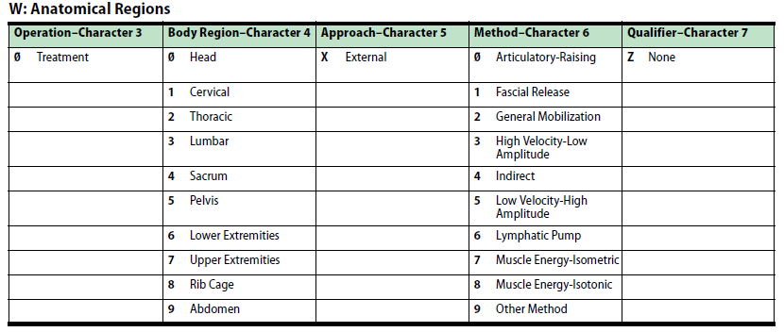
Osteopathic 7W0
Character meanings

Slide 7
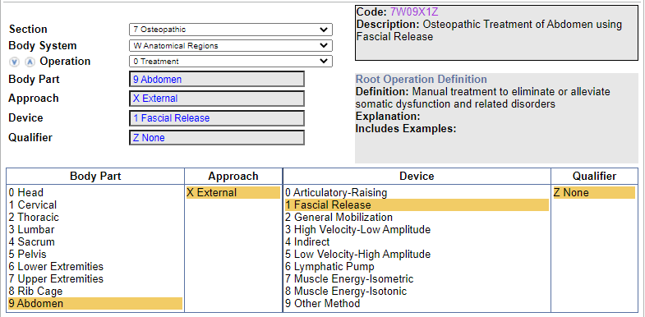
Clinical Example 1
Fascial release of abdomen, osteopathic treatment
Coding Navigation:

Slide 8
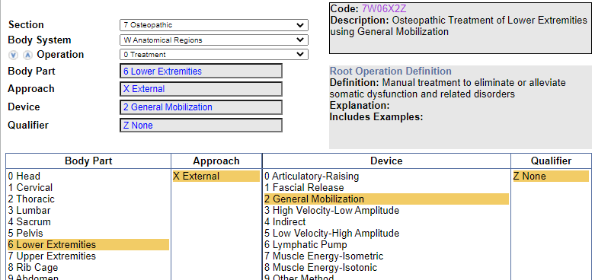
Clinical Example 2
General osteopathic mobilization of legs
Coding Navigation:

Slide 9
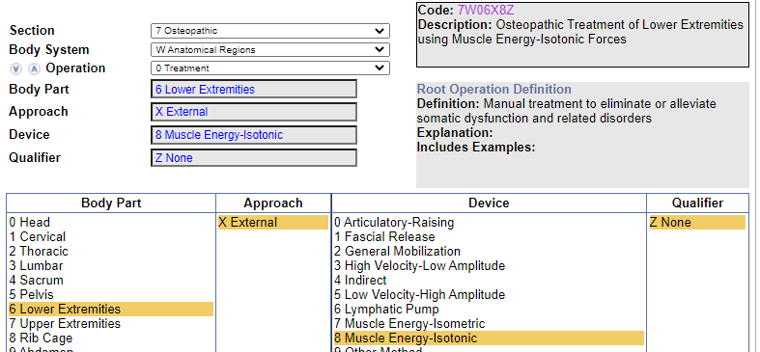
Knowledge Check 1
What is the code assignment for Isotonic muscle energy treatment of right leg?
Codes: 7W06X8Z (Osteopathic Treatment of Lower Extremities using Muscle Energy-Isotonic Forces)
Code Navigation:

Slide 10
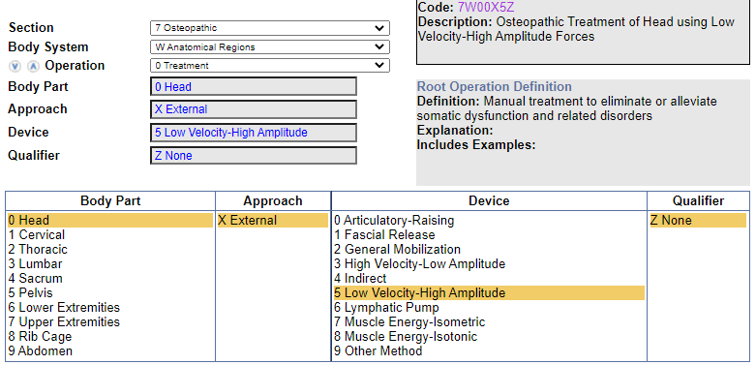
Knowledge Check 2
What is the code assignment for Low velocity-high amplitude osteopathic treatment of head?
Code: 7W00X5Z (Osteopathic Treatment of Head using Low Velocity-High Amplitude Forces)
Code Navigation:

Slide 11
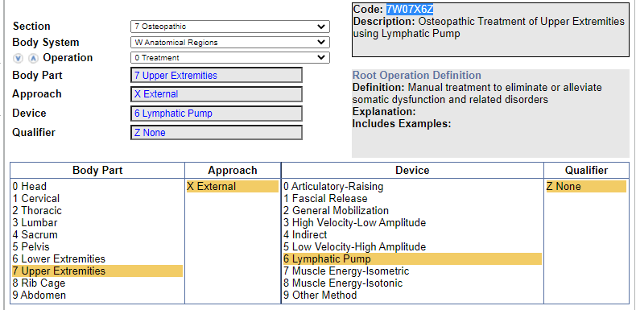
Exercise 1
What is the code assignment for Lymphatic pump osteopathic treatment of left axilla?
Code: 7W07X6Z (Osteopathic Treatment of Upper Extremities using Lymphatic Pump)
Code Navigation:

Slide 12
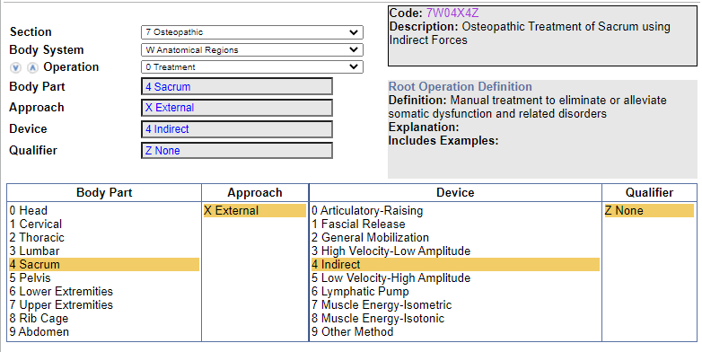
Exercise 2
What is the code assignment for Indirect osteopathic treatment of sacrum?
Code: 7W04X4Z (Osteopathic Treatment of Sacrum using Indirect Forces)
Code Navigation:

Slide 13
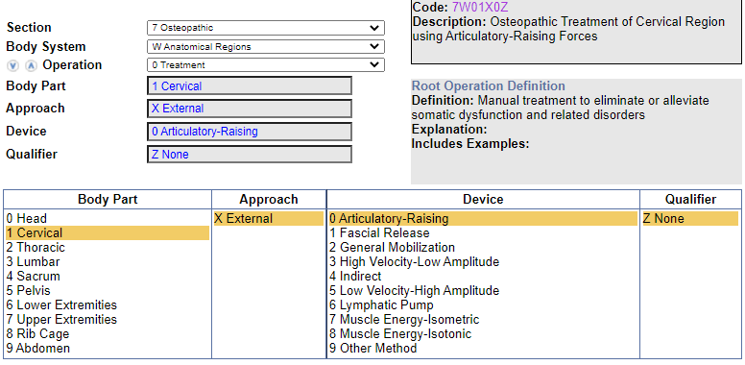
Exercise 3
What is the code assignment for Articulatory osteopathic treatment of cervical region?
Code: 7W01X0Z (Osteopathic Treatment of Cervical Region using Articulatory-Raising Forces)
Code Navigation:

Slide 14
Thank You

